Slide 1
Decision Trees to Predict Success in Saber Pro
Simón Lopera
Juan Jose Escobar
Medellín, May 21 2019

Slide 2
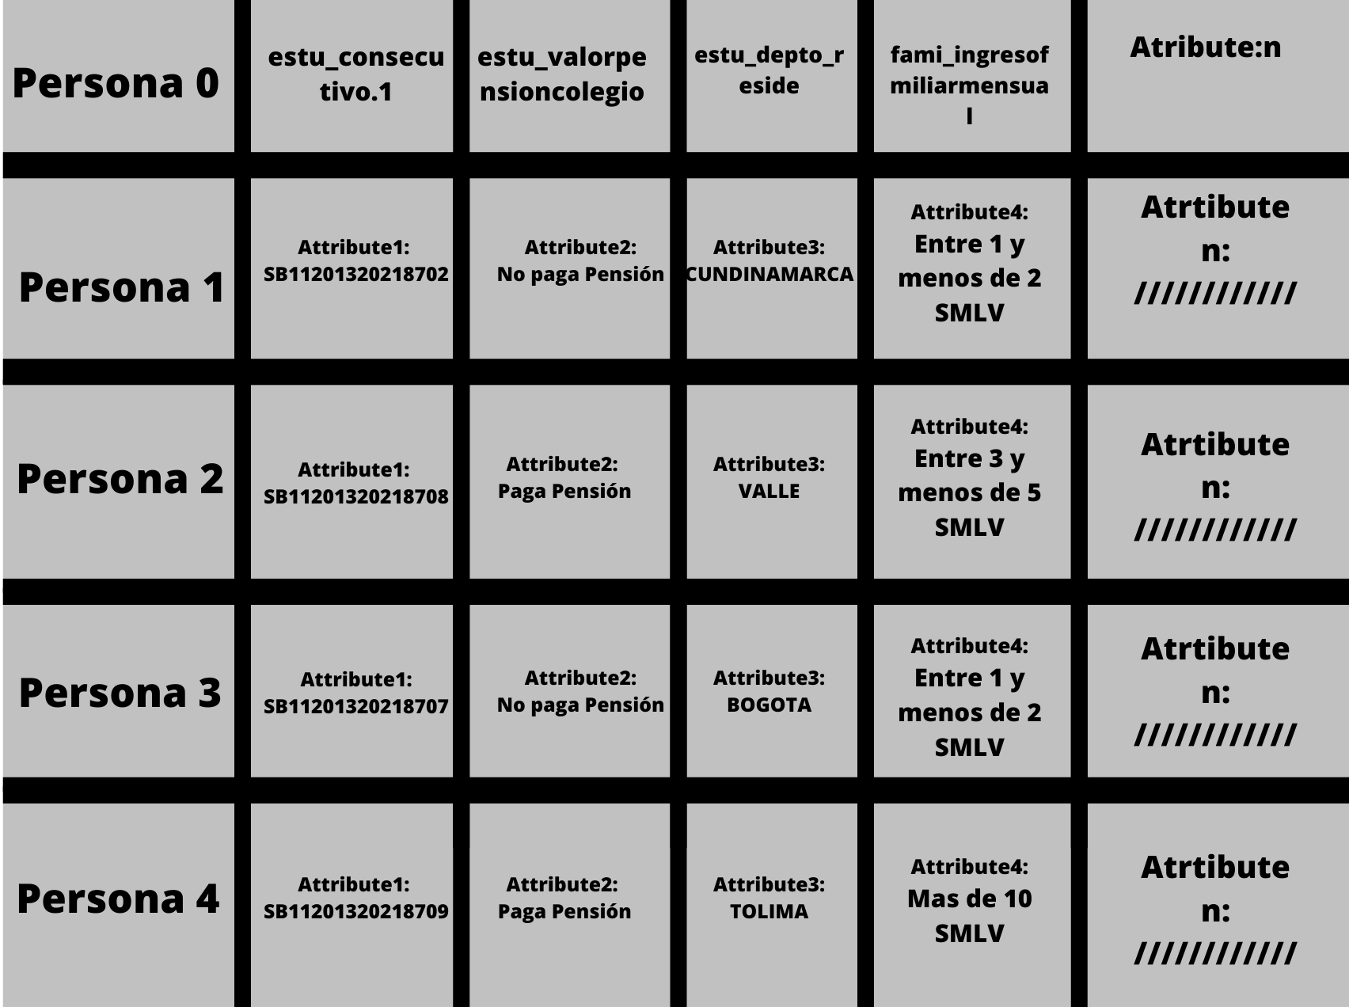
Data Structure
2D array with a defined size
First row stores the name of all of the variables
Each of the following rows stores a person with all of its corresponding attributes
Every value is stored as a String since it a String 2D array.

Slide 3
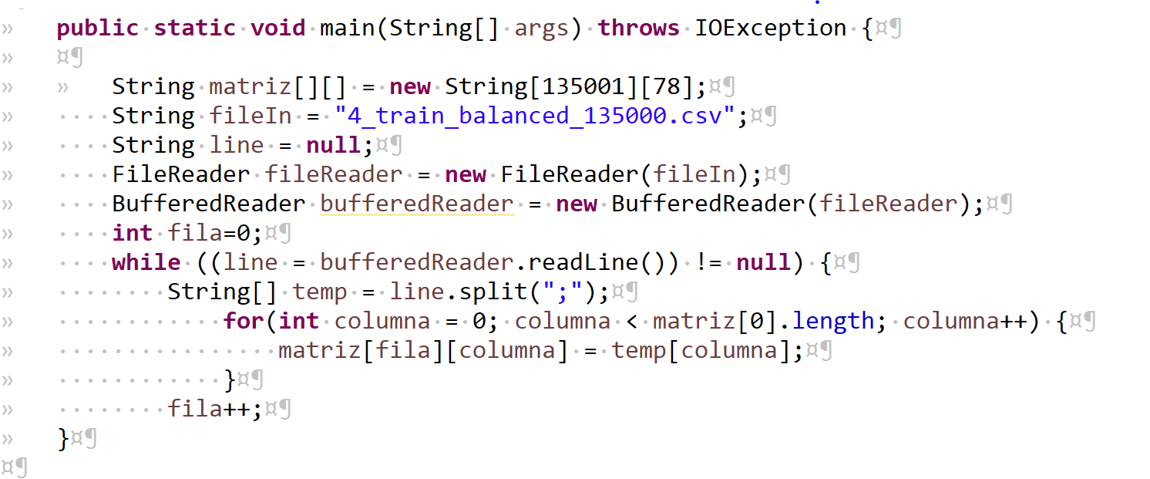

Data Structure Operations
We filled up the 2D array as we read the .csv files O(n)
No need to use Insertion , Deletion, or any other operations.
The only function we needed to use for the tree was get
If we wanted to know departamento for Persona 2:
We can simply do Matrix[3][2]
This will give us: VALLE

Slide 4
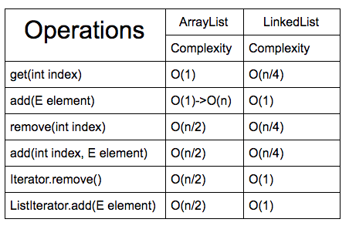
Design Criteria of the Data Structure
The size of the array is already defined by the amount of data so it can be easily implemented
Easy access to each attribute from any person
No need to Insert or Delete
If we used ArrayList or LinkedList we would have complexities of O(n) for simple operations like add, with 2D Arrays it maintains a O(1) complexity for the functions used in the creation of the tree
https://medium.com/@govinda_raj/arraylist-vs-linkedlist-f8c5099153b5

Slide 5
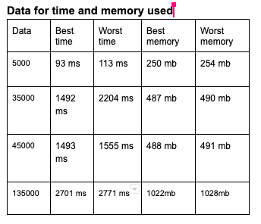
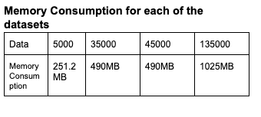
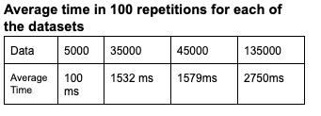
Time and Memory Consumption

Slide 6
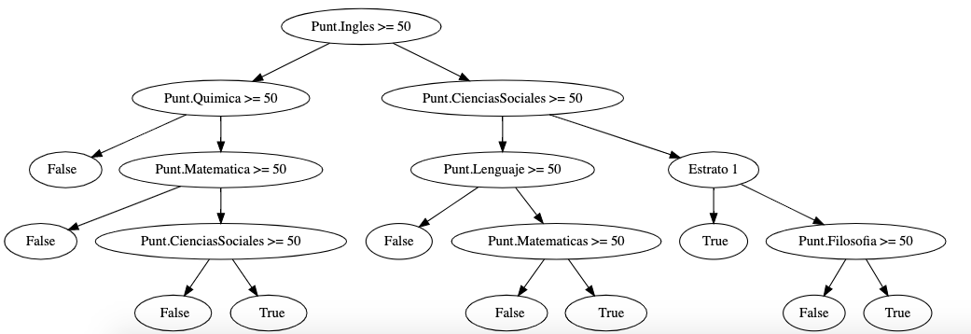
CART Binary Tree

Slide 7

Implementation

